Slide 1
EE: User Interface Design
Sept. 7, 2017

Slide 2
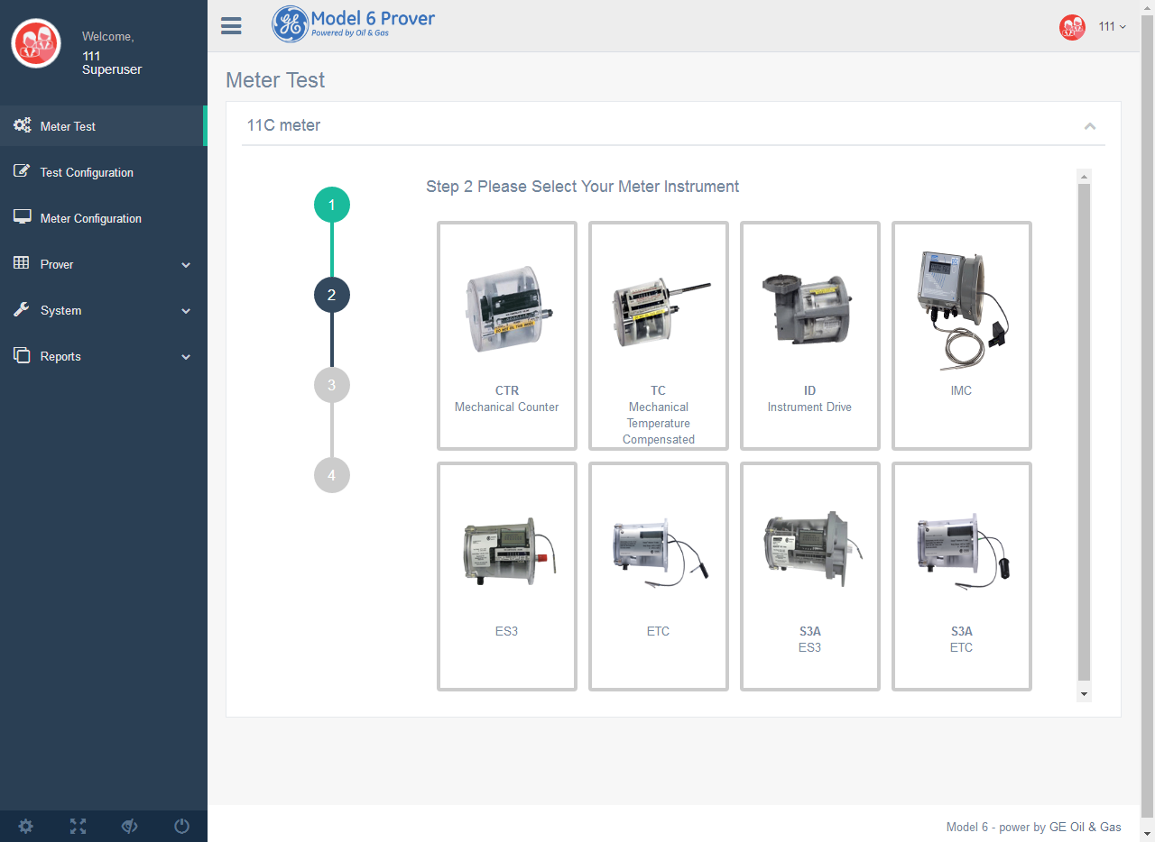
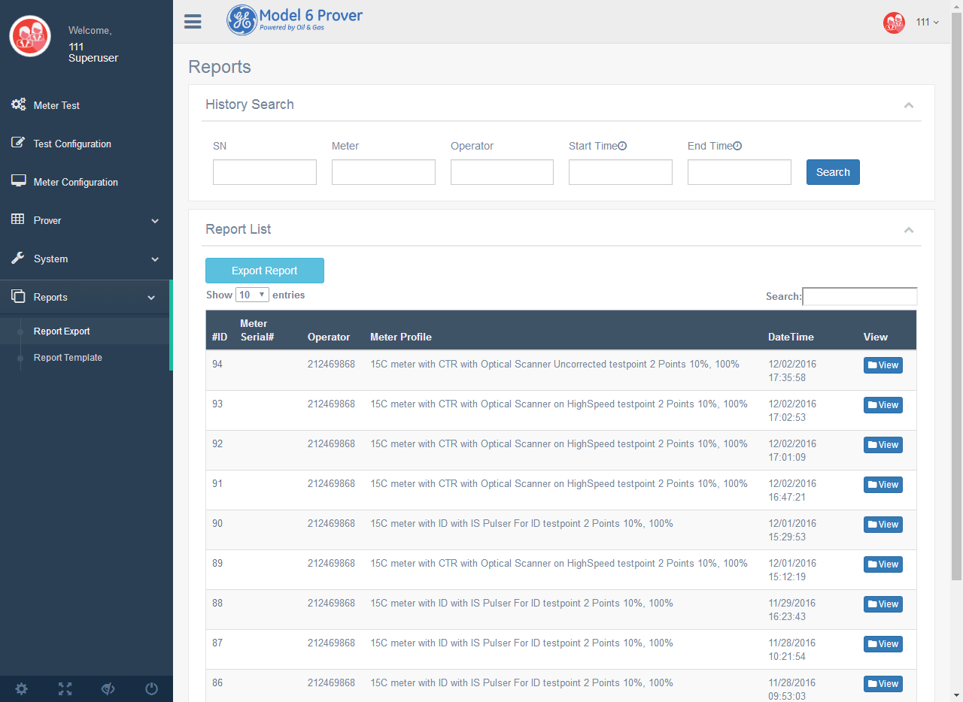
Projects - Low cost and Fast Web Server
demo

Slide 3
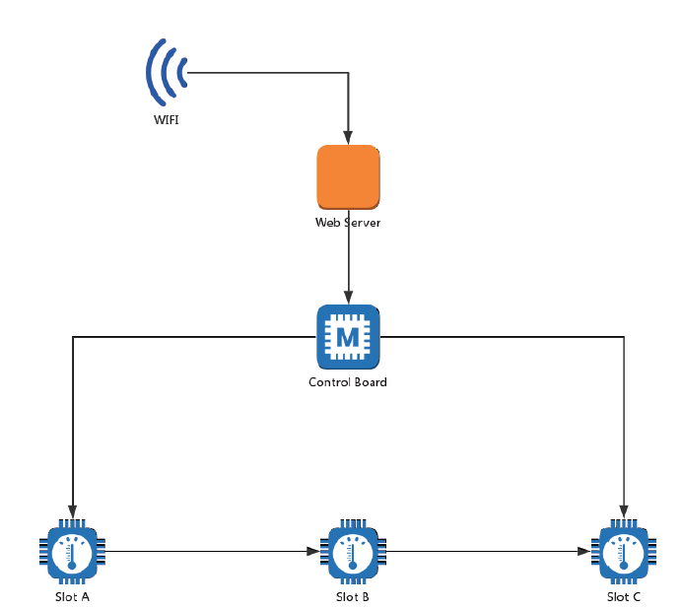
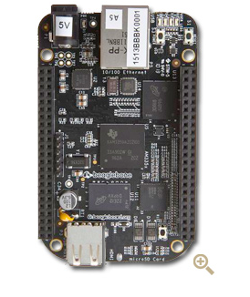
Architecture
RS485
CoAP

Slide 4

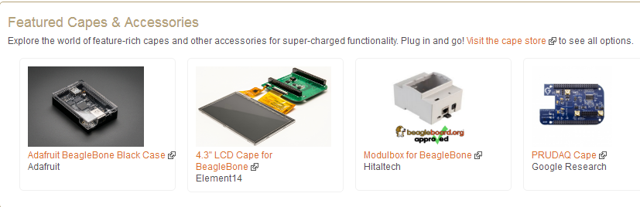
Hardware— RMB 300-1000

Slide 5





Software--Free

Slide 6
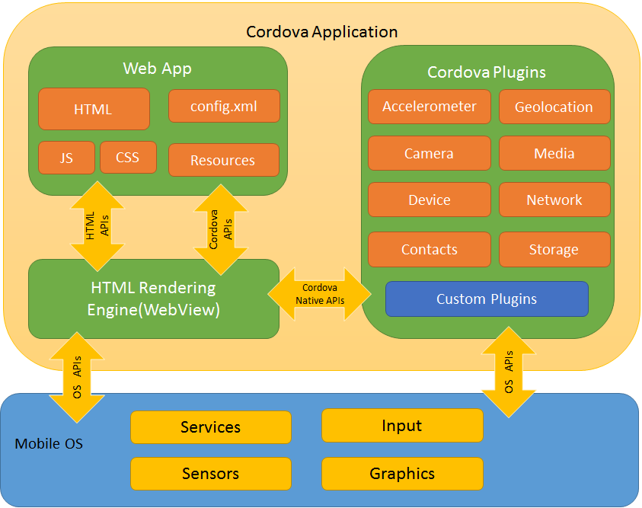

Slide 7
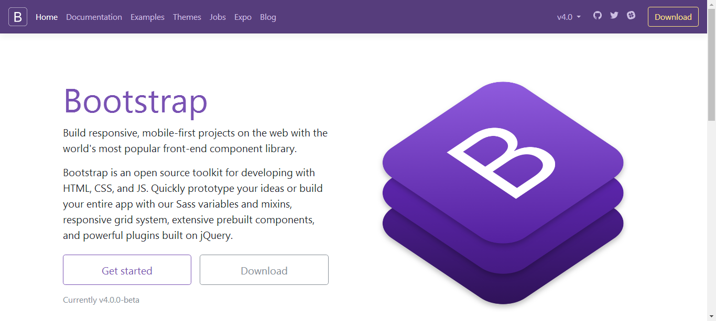

Slide 8

Notes:
Show picture of Engineering Leader and direct staff only
Show if applicable any currently open leadership roles
The total number of salaried employees in their organization.
List any potential organization changes/restructure, or challenges

Slide 9
Free to use Bootstrap3 admin template.
Theme uses several libraries for charts, calendar, form validation, wizard style interface, off-canvas navigation menu, text forms, date range, upload area, form autocomplete, range slider, progress bars, notifications and much more.
Template Demo
Notes:
Show picture of Engineering Leader and direct staff only
Show if applicable any currently open leadership roles
The total number of salaried employees in their organization.
List any potential organization changes/restructure, or challenges

Slide 10
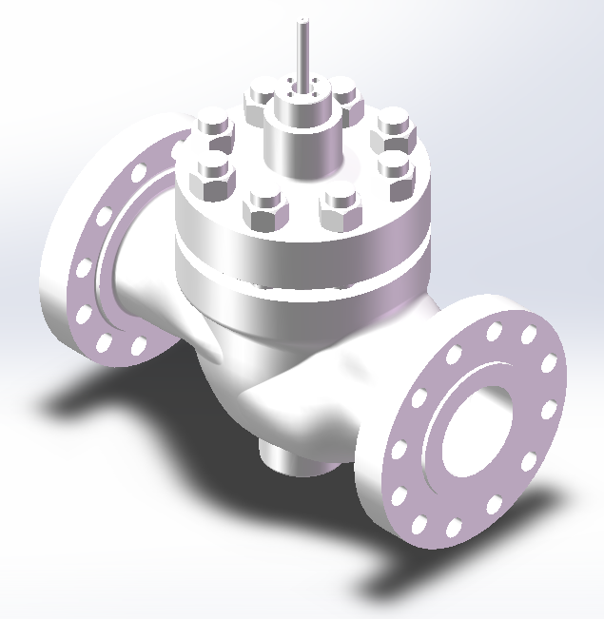
Projects - Valve User Manual 3D Animation
Demo

Slide 11

Projects - Valve User Manual 3D Animation
Two pieces of animation
Assembly and disassembly processes
Valve body and actuator
Step-by-step instructions
Text explanations for each step
Animation functions
Start/End/Pause/Next/Back
Flexible camera view with default recommendations
Hyperlink back to origin
Notes:
Show picture of Engineering Leader and direct staff only
Show if applicable any currently open leadership roles
The total number of salaried employees in their organization.
List any potential organization changes/restructure, or challenges

Slide 12

Projects - Valve User Manual 3D Animation
Model demonstration
Valve body and actuator
Semi-transparent mode
Mouse functions
Show part name and ID number
Reveal detailed part information
Demonstrate single part
Hyperlinks to animations
Component inventory
Notes:
Show picture of Engineering Leader and direct staff only
Show if applicable any currently open leadership roles
The total number of salaried employees in their organization.
List any potential organization changes/restructure, or challenges

Slide 13
What is Unity3D?
Unity3D is a powerful cross-platform 3D engine and a user friendly development environment. Easy enough for the beginner and powerful enough for the expert; Unity should interest anybody who wants to easily create 3D games,VR,AR and applications for mobile, desktop, the web, and consoles.

Slide 14
Cost
Indie developers rejoice, Unity is free! Well, almost. There is a Pro edition that comes with more features and tools, but will set you back $1,500. Considering the feature set and how permissive the Unity publishing license is, this price is actually very reasonable. However, the free version will let you get your feet wet, build complete games, and even publish them to the desktop and the web without paying a cent! The only caveat is that games published under the free edition will have a small Unity watermark.
Anything built in Unity will work exactly the same way in Unity Pro. This means you can choose to upgrade at any point if you need the additional features, or want to publish to more platforms such as iOS and Android. There’s also a 30 day Pro trial you can sign up for in order to test drive all the extra features!

Slide 15

Why we give up this library
Not yet available beyond betaversions of Firefox, Opera, Safari and Chrome browsers. Later this year seems to be current best guess for spec hitting v1.0. Seems that the remaining issues are related to getting security right. Good news is that as soon as spec is signed of on then implementations should be ready to roll out.
Microsoft has not signed on. The way to get it to run in IE will likely by with the Chrome Frame plugin.
Depends on having OpenGL 2.0 drivers present which many computers will not have.
Despite recent improvements Javascript may still feel too slow or just plain unfamiliar to people used to writing rich 3D applications.
Most developer libraries are still in an early stage.
Notes:
Show picture of Engineering Leader and direct staff only
Show if applicable any currently open leadership roles
The total number of salaried employees in their organization.
List any potential organization changes/restructure, or challenges

Slide 16
Demo
Notes:
Show picture of Engineering Leader and direct staff only
Show if applicable any currently open leadership roles
The total number of salaried employees in their organization.
List any potential organization changes/restructure, or challenges

